Slide 1

Strategic Insights and Performance Overview

Slide 2
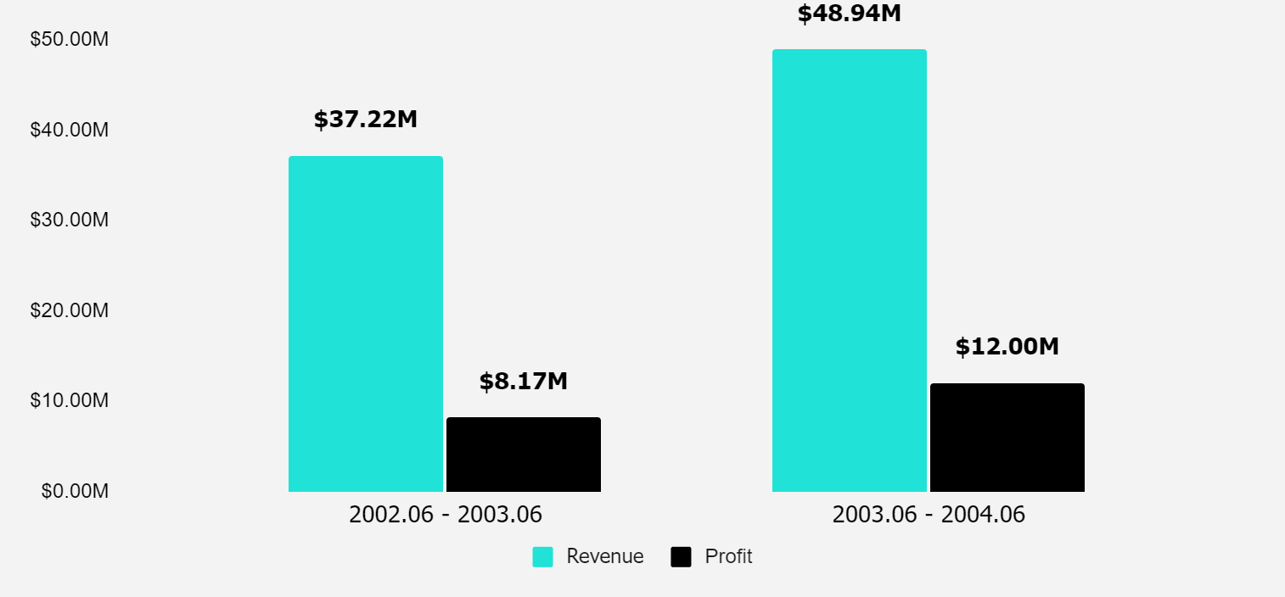
The pricing changes we made in july led to significant benefits in both profit and revenue.
REVENUE AND PROFIT FROM WHOLESALE
Revenue from wholesales increased by 31.44%
Revenue increased by 54%
Profits increased by 90.27%
Profits from whole sales increased by 46.88%

Slide 3
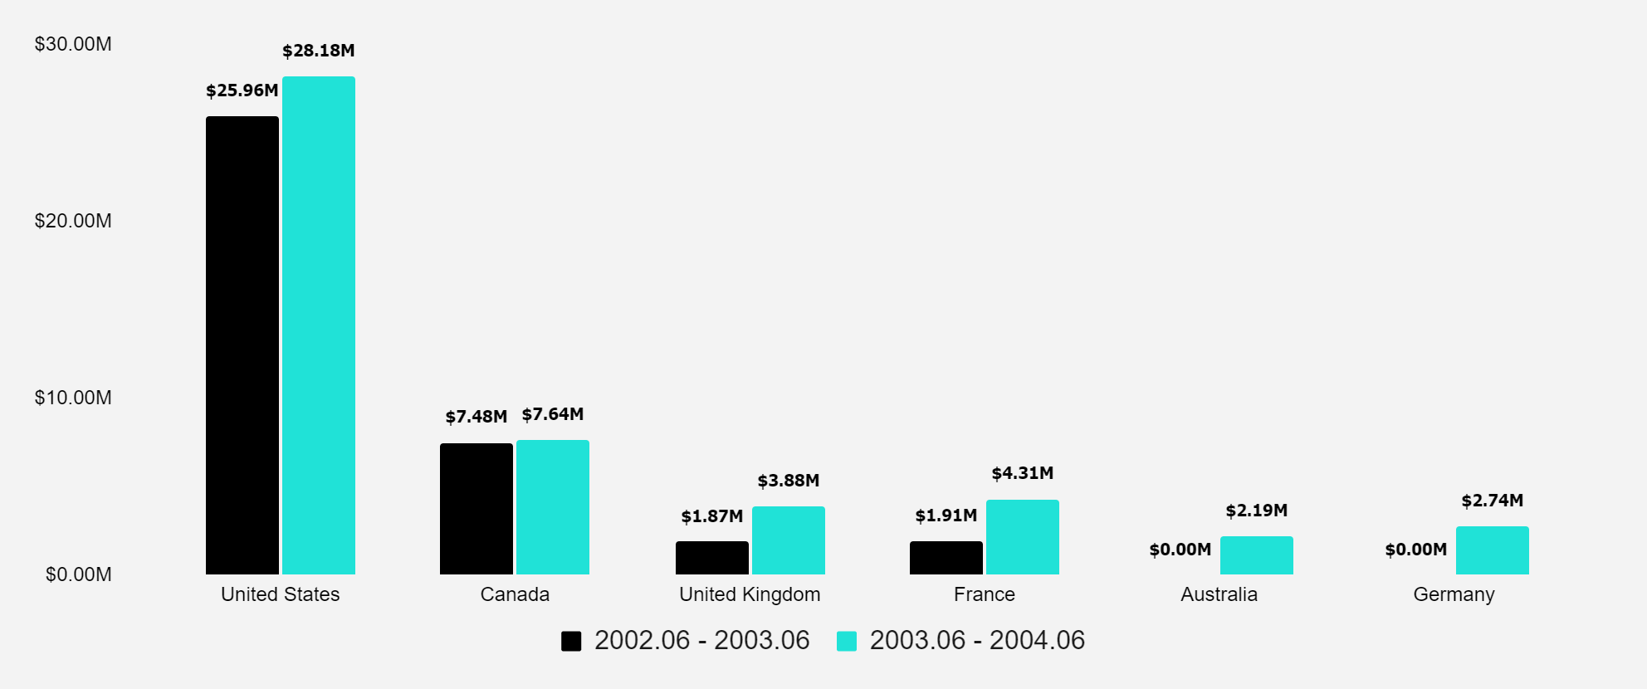
International revenue surge: Capitalizing on global markets
REVENUE BY COUNTRY
Revenue in our main market is growing, with a 8.58% increase in wholesale this year.

Slide 4
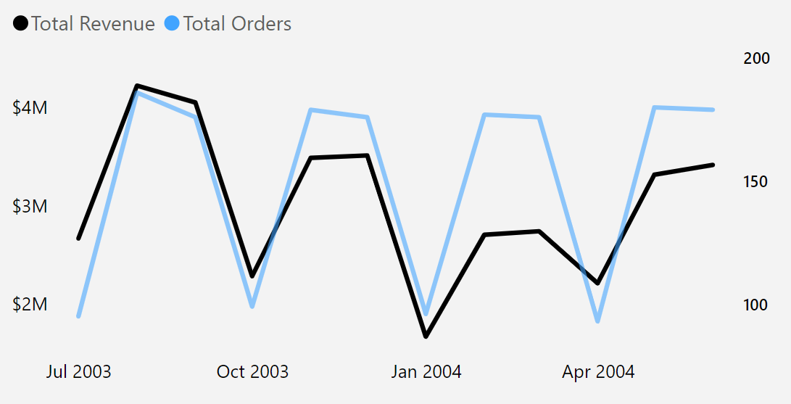
Monthly sales revenue: Seasonal peaks and strategic insights

Slide 5
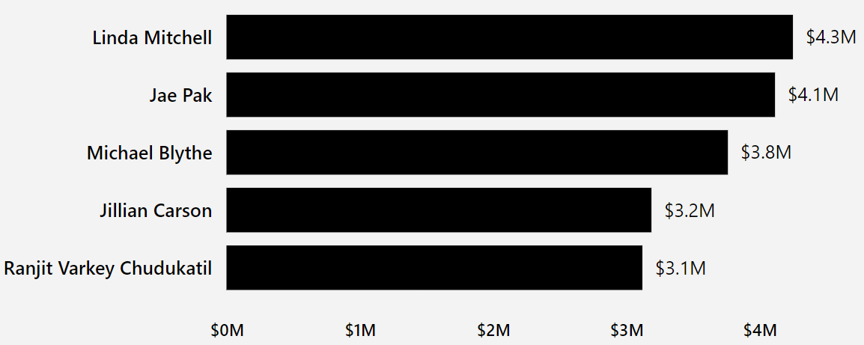
Top 5 sales performers of the year
Ranjit Varkey Chudukatil is responsible for 98.17% of total wholesale revenue from France.

Slide 6
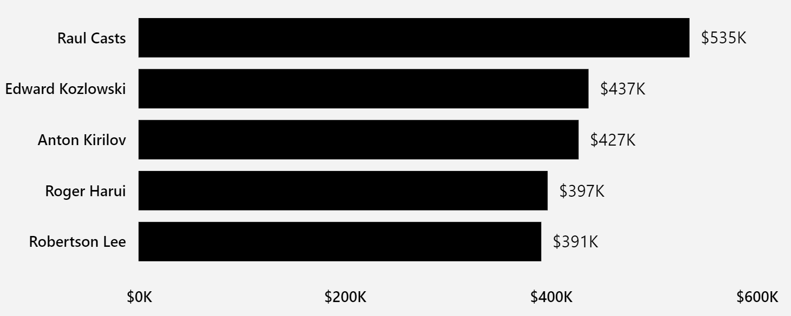
Top 5 customers of the year: Key revenue contributors

Slide 7
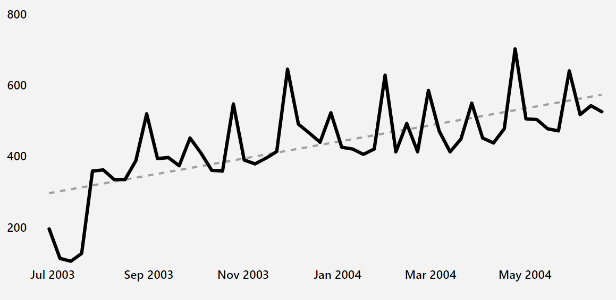
Total weekly customers

Slide 8
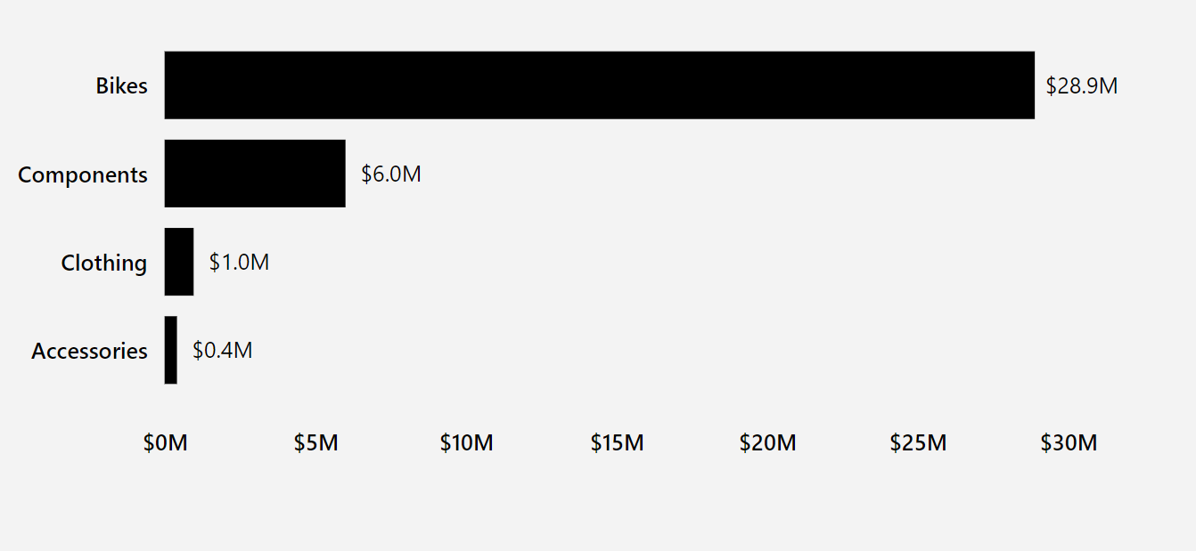
Bikes dominate as our leading product category

Slide 9
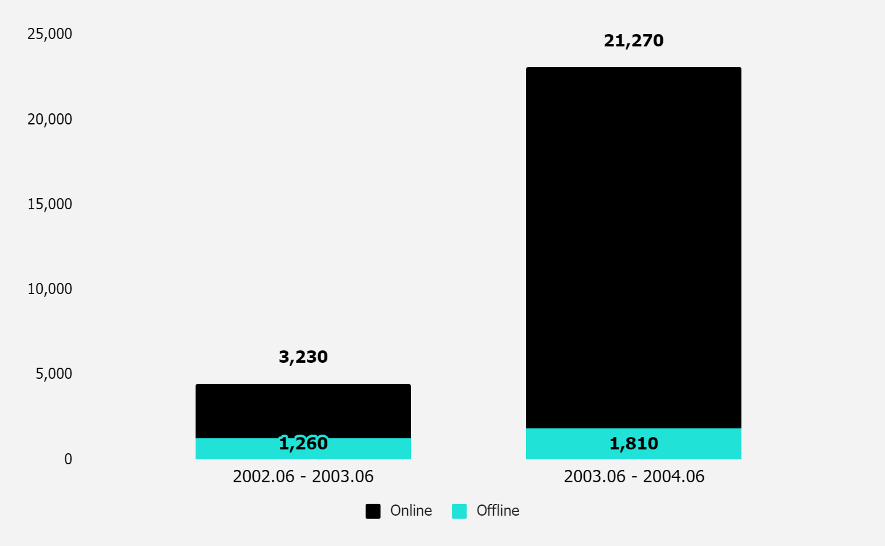
Online channels lead the charge in number of orders
ONLINE AND WHOLESALE ORDERS

Slide 10
Strong performance in key markets, but let’s explore ways to boost sales in Canada and other underperforming regions.
Use data-driven insights to tailor online campaigns and promotions, targeting key customer segments and high-growth regions.
Invest in digital marketing and e-commerce tools to convert more online leads, drive customer engagement, and increase overall sales performance.

